Slide 1

Software Developer’s Career
Tabish Parkar
24/10/2023

Slide 2
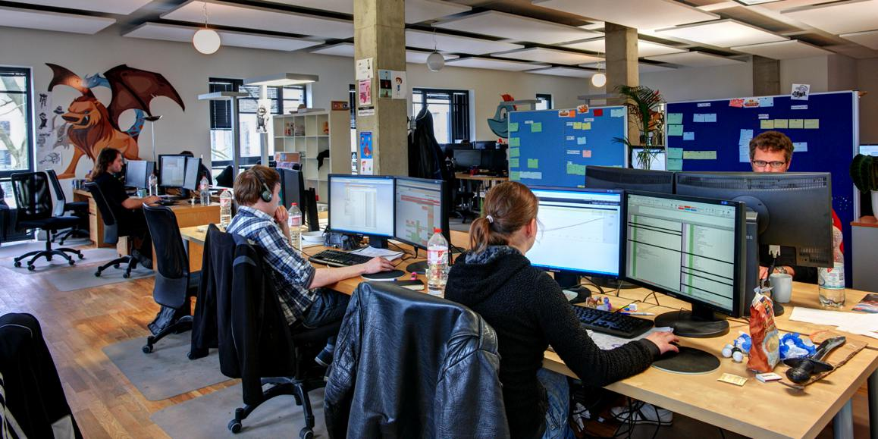
Software development is a rapidly growing faculty with a high demand for skilled professionals.
You can specialize in various areas such as web development, mobile app development, software engineering or data analysis.
Software developers analyze complex issues, identify solutions and make efficient and user-friendly software applications for specific needs.
By going to university and obtaining a Bachelor's degree in Computer Science, Software Engineering, or any related field is your path to get into software. Certifications would also suffice.
A career like this also requires constant learning as technology keeps on advancing and new languages are made.

Slide 3


Microsoft Certified Professional
Successfully pass one or more exams in Microsoft technologies such as Azure, Windows, Office 365 or SQL.
Have a passing score on the exams to show proficiency.
One must maintain their certification by staying updated with new technology through recertification or by earning more education credits.
Oracle Certified Professional
Complete the required training courses given by Oracle University.
Successfully pass the certification exams to show knowledge and skills in Oracle technologies.
Complete any additional requirements for example having work experience or finishing specific projects.

Slide 4
https://youtu.be/5FySFg78cQI?si=BTLh6tBJ07Mtw4aJ
The video above provides insight about a career in software development
You will always have to do a trial-and-error process to keep on advancing your knowledge in coding.
Constant learning and practice is key in software development
Always stay up to date with latest technology in coding.
Coding is not for the faint hearted. Lots of hard work is needed and you can get a job freelancing for experience to get a job in a big firm.

Slide 5
Reasons And Challenges for my career choice
I chose this career as I was really interested in computers.
I was interested in how apps are built.
I am interested in the latest technologies and how its coded to make it work.
I have always wanted to make apps that help people when they need it on demand.
I also chose this career in order to hopefully start my own software firm with a few friends and intertwine their fields of study into the company.
Challenges
Staying inside in front of a screen can be frustrating sometimes
One has to spend most of their time indoors doing constant learning and do not have a social life. Relationships will be broken apart between a software developer.

